Slide 1

ABC Call Volume Trend Analysis
- Rachit Dani

Slide 2
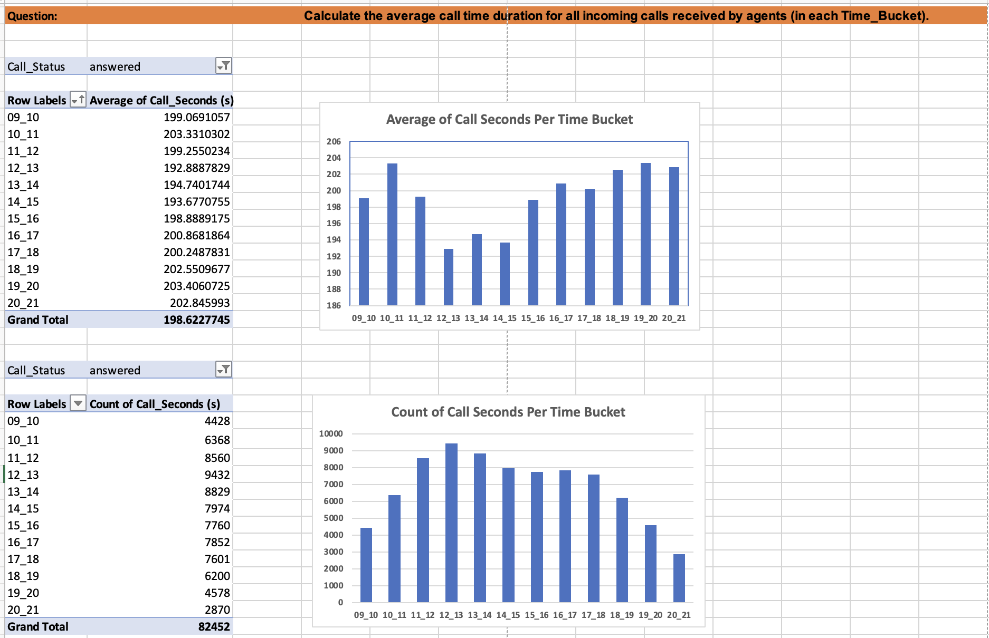

Slide 3
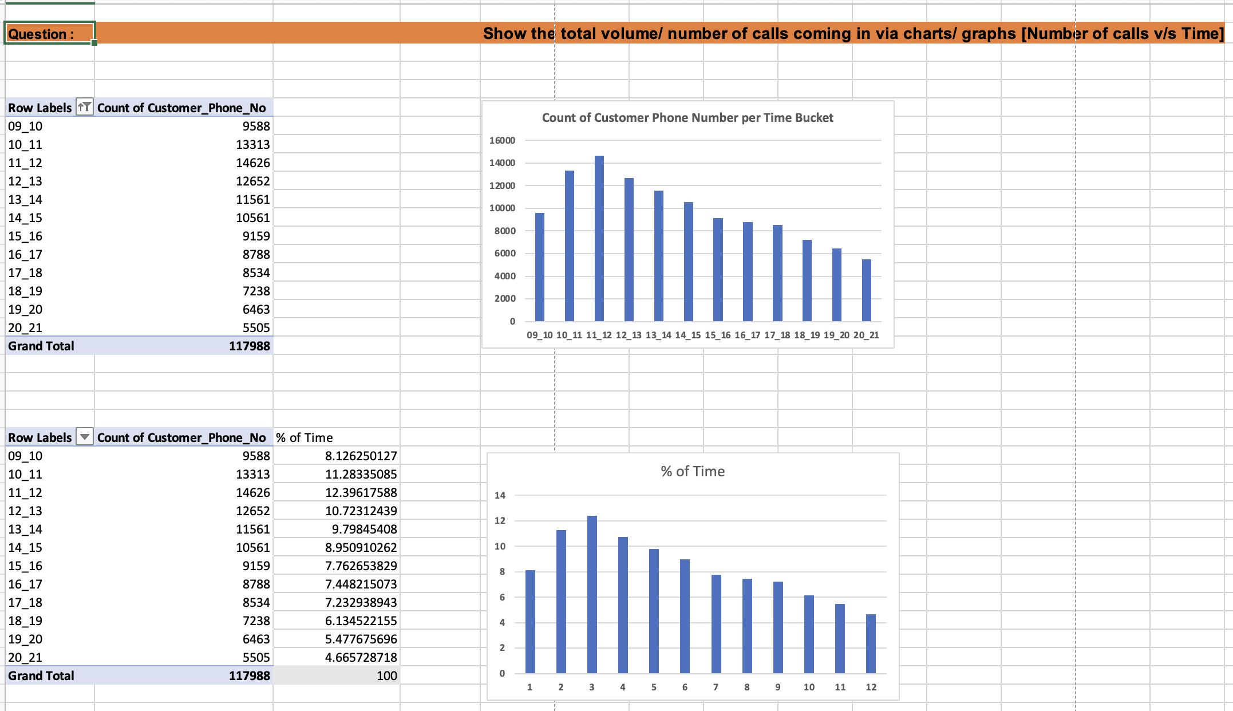

Slide 4
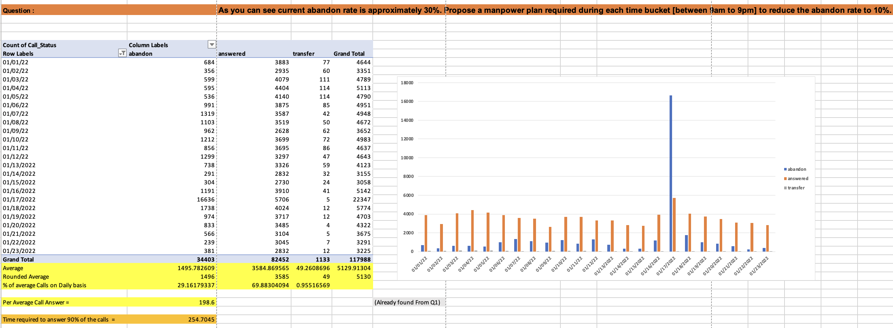

Slide 5
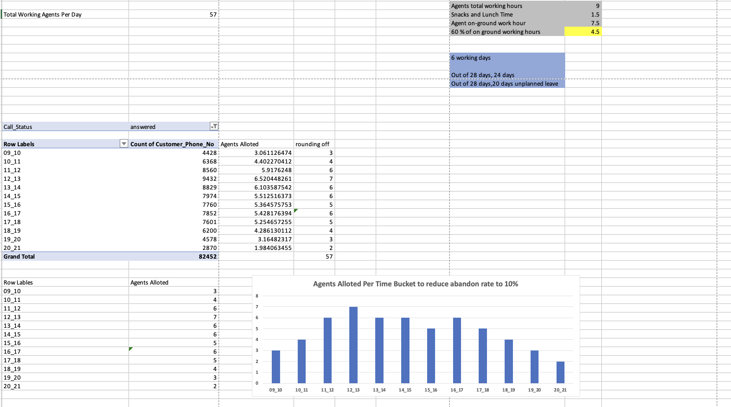

Slide 6
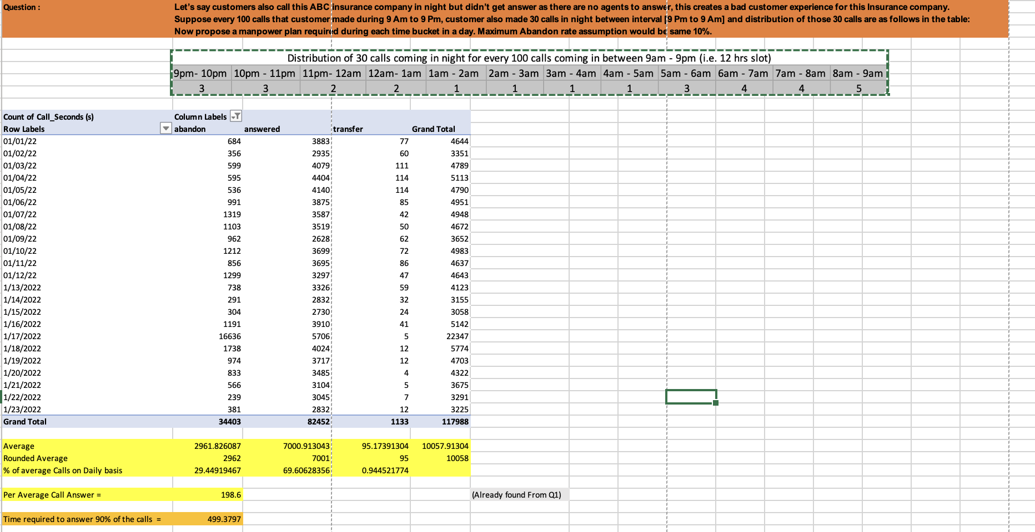

Slide 7
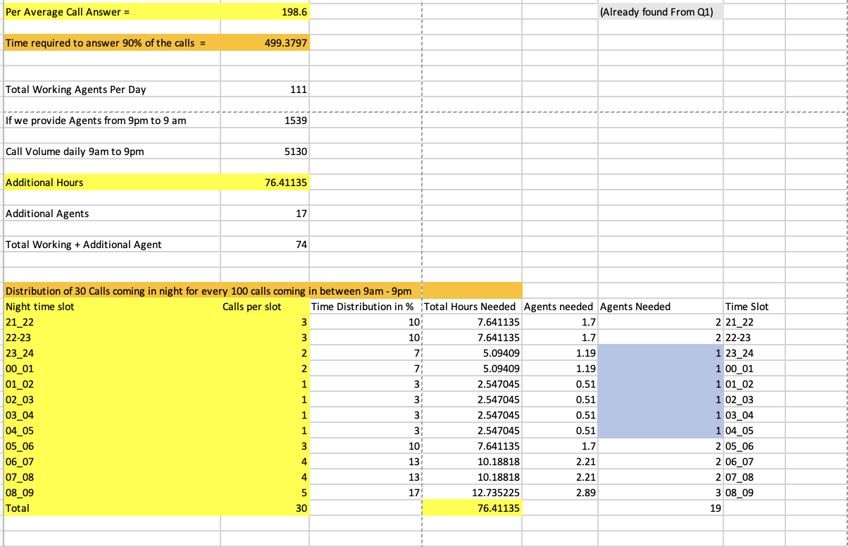

Slide 8
Link to Excel Sheet :
https://docs.google.com/spreadsheets/d/1EQmY2xRkdRV8GNLmzxz02dqN0jx1LOEn/edit?usp=sharing&ouid=103609756645944949726&rtpof=true&sd=true

